Slide 1
SIEM SPLUNK
PRESENT, SOLOMON HENRY

Slide 2

About this project
Analyzing HTTP Log Files
Search for HTTP Events
Extract Relevant Fields
Analyze Web Traffic Patterns
Detect Anomalies
Monitor User Behavior
Analyzing SSH Log Files
Search for SSH Events
Extract Relevant Fields
Analyze SSH Activity Patterns
Detect Anomalies
Monitor User Behavior
Analyzing Tunnel Log Traffic
Search for Tunnel Events
Extract Relevant Fields
Analyze Tunneling Protocols
Detect Anomalies
Monitor GRE Tunneling Activity
Analyzing DNS Log Files.
Search for DNS Events.
Extract Relevant Fields
Identify Anomalies
Find the top DNS sources
Investigate Suspicious Domains
Analyzing FTP Log Files
Search for FTP Events
Extract Relevant Fields
Analyze File Transfer Activity
Detect Anomalies
Monitor User Behavior
Analyzing SMTP Log Files
Analyzing DHCP Log Files

Slide 3
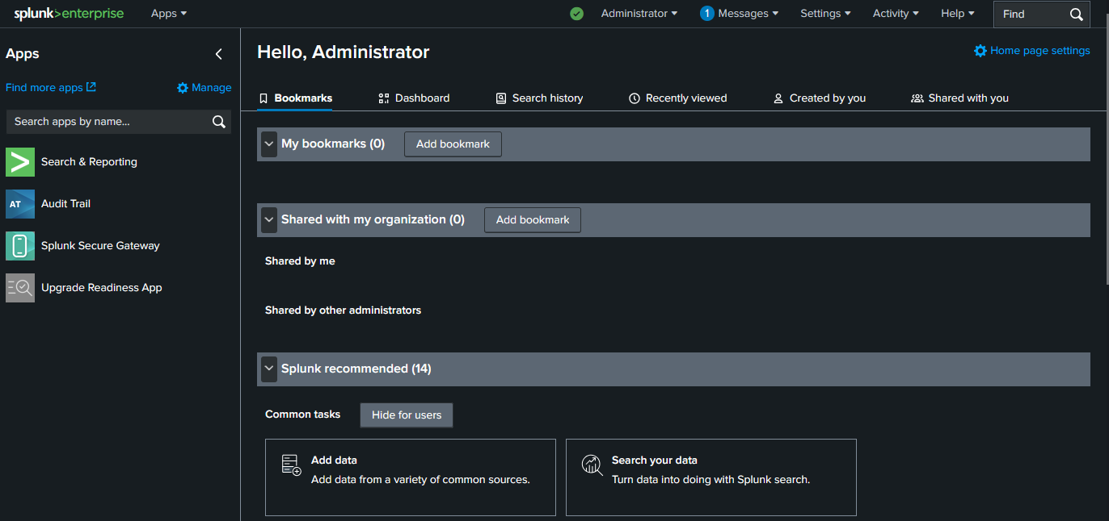
Installing my splunk enterprise

Slide 4
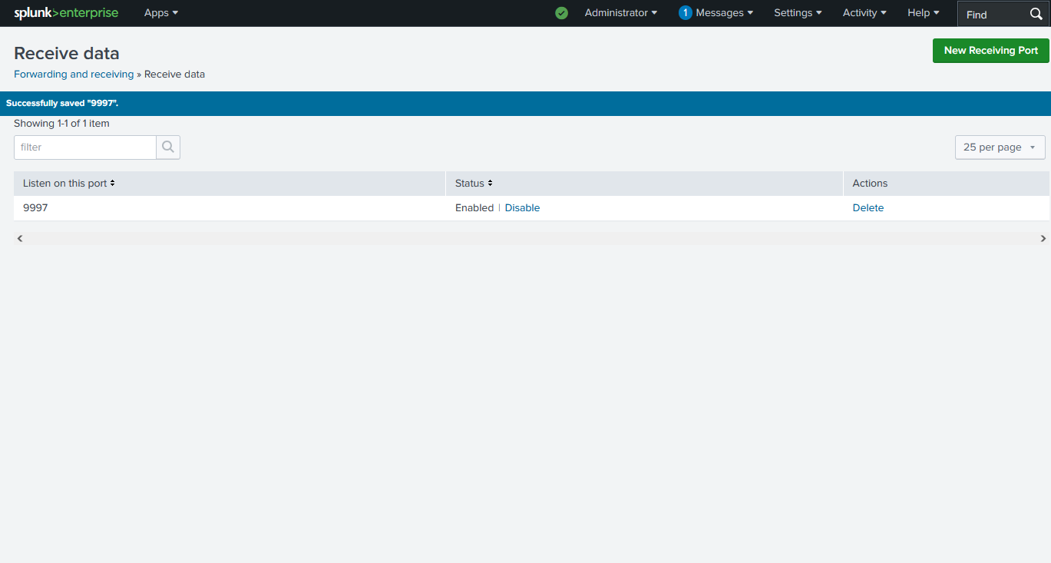
Configuring listening port

Slide 5
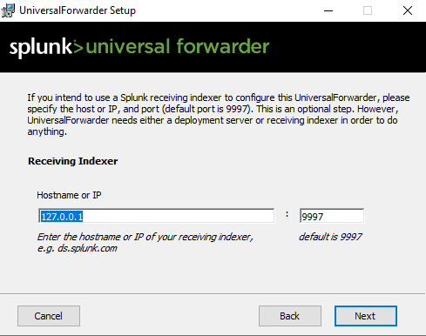
Configuring my splunk forwarder hostname & ip

Slide 6
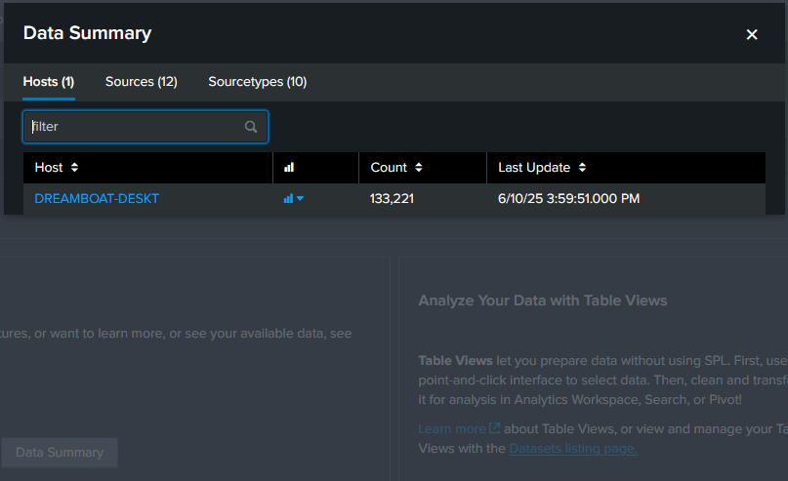
Data summary

Slide 7
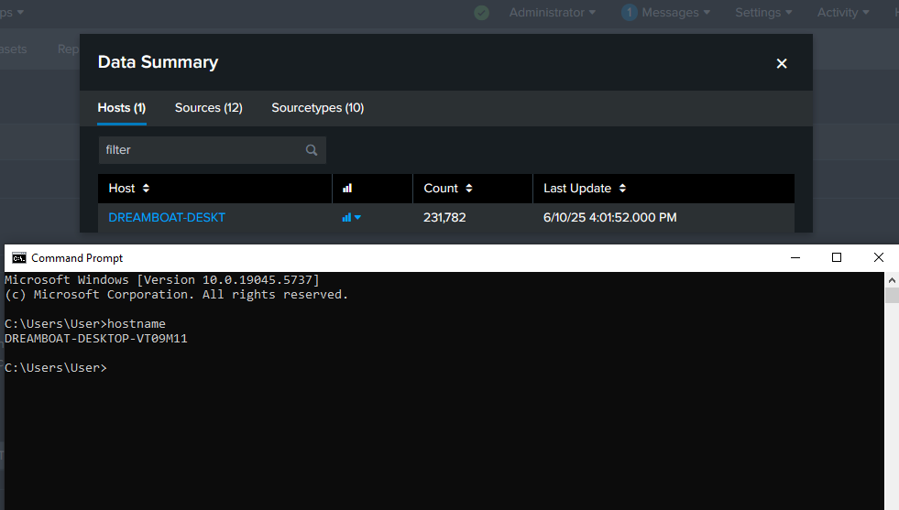
Pinging my host on command prompt

Slide 8
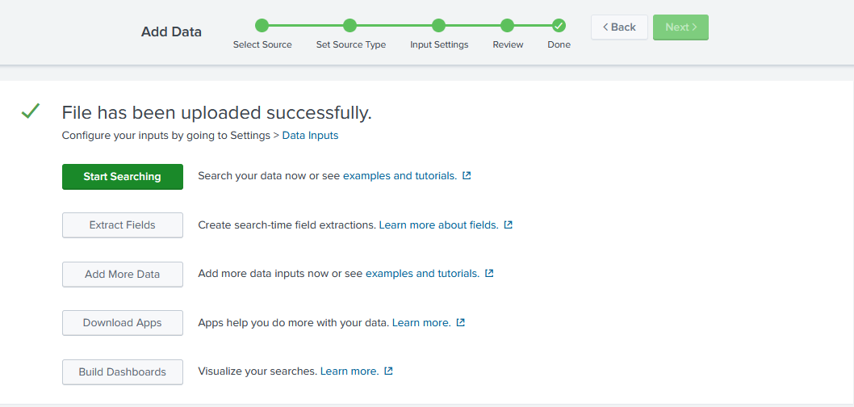
Uploaded my dns logs file

Slide 9
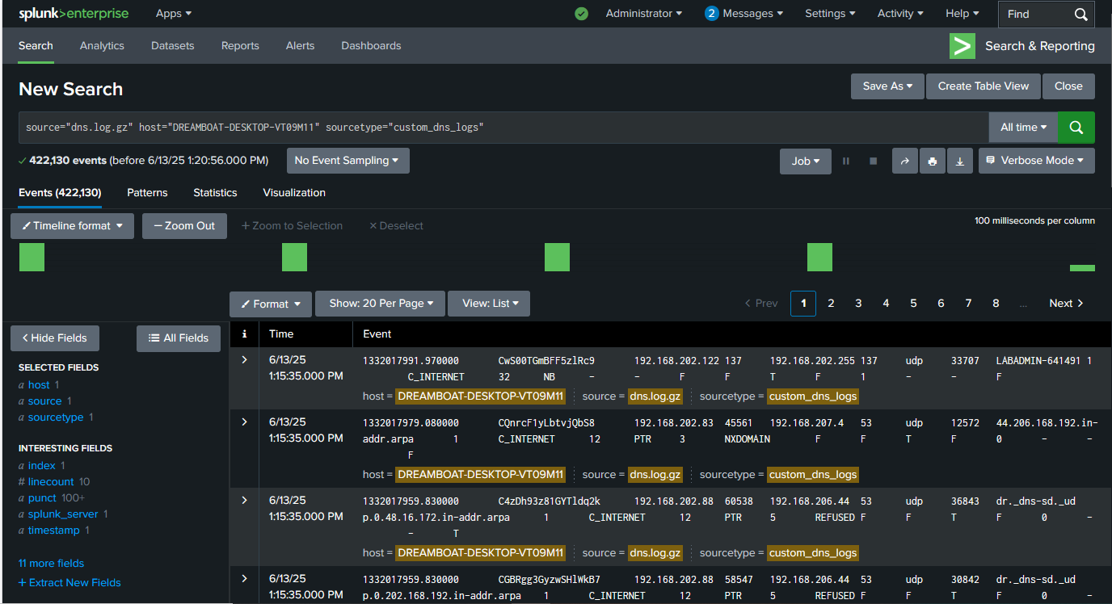
Zeek-Formatted DNS LogS

Slide 10
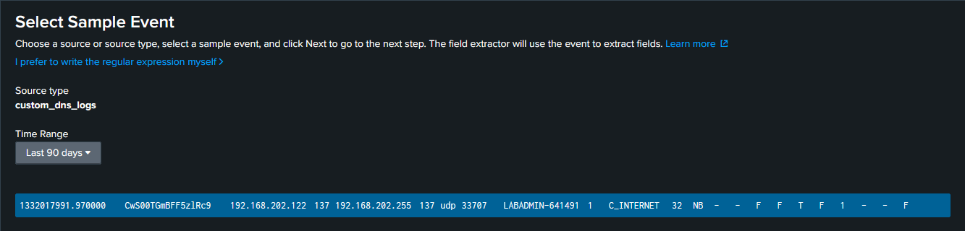
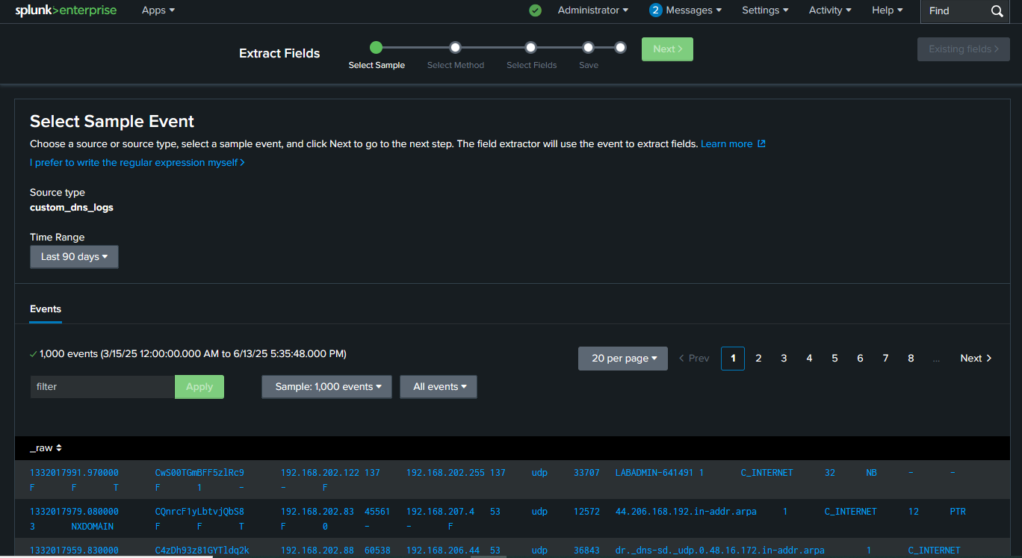
This tells Splunk, “I want to extract fields from this sample log format.”

Slide 11
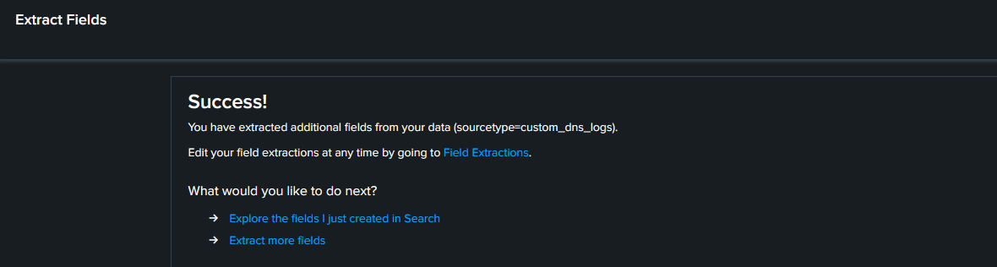
manual regex extraction for the custom_dns_logs sourcetype. using the regex route it gives me better control, accuracy for my DNS log fields.

Slide 12
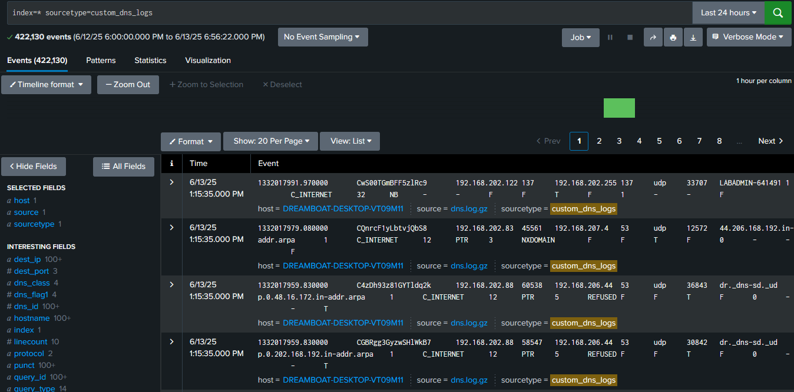
Searching for dns events

Slide 13
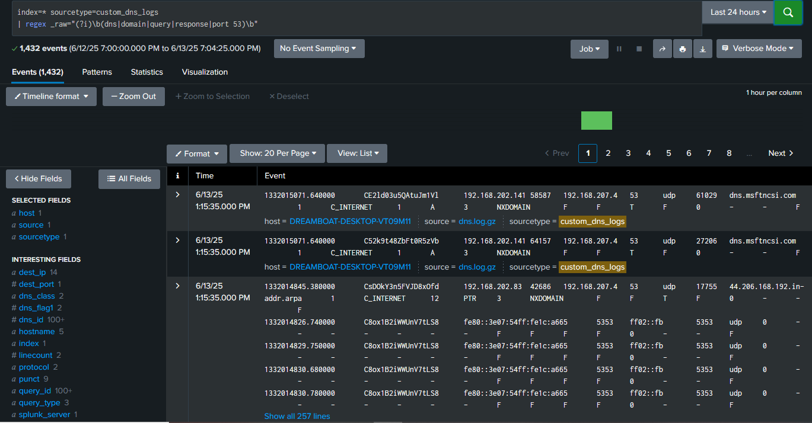
Extracting Relevant Fields

Slide 14
Identifying dns anomalities
Anomalies in DNS logs often point to suspicious or abnormal behavior — for example:
Unusually high number of DNS queries from a single source (possible malware or tunneling).
Requests to rare or suspicious domain names (e.g., xyz123.baddomain.ru)
Repeated NXDOMAIN responses (domain not found).
Use of uncommon record types (e.g., TXT, NULL, ANY).
Excessive queries outside business hours.

Slide 15




IDENTIFY ANOMALITIES
Unusually high number of DNS queries from a single source (possible malware or tunneling).
Requests to rare or suspicious domain names
Use of uncommon record types (e.g., TXT, NULL, ANY).
Excessive queries outside business hours.
Anomalies in DNS logs often point to suspicious or abnormal behavior.

Slide 16
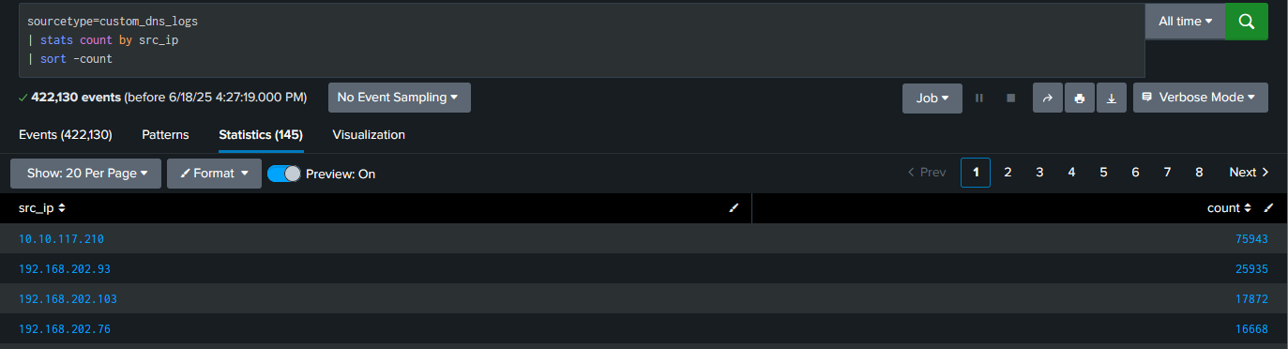
Identify anomalies

Slide 17
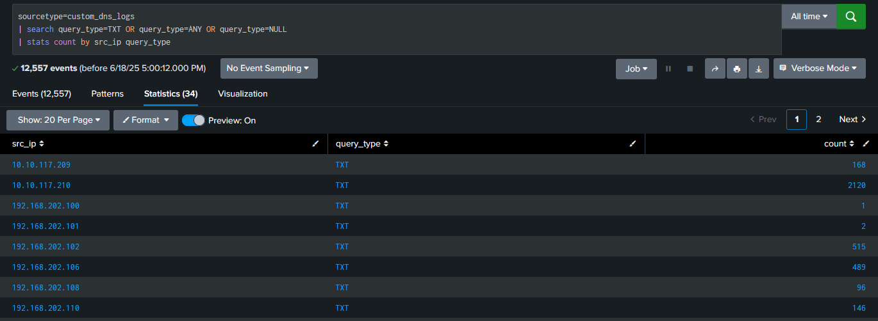
Top dns source & Unusual Record Types Like TXT, NULL, or ANY

Slide 18
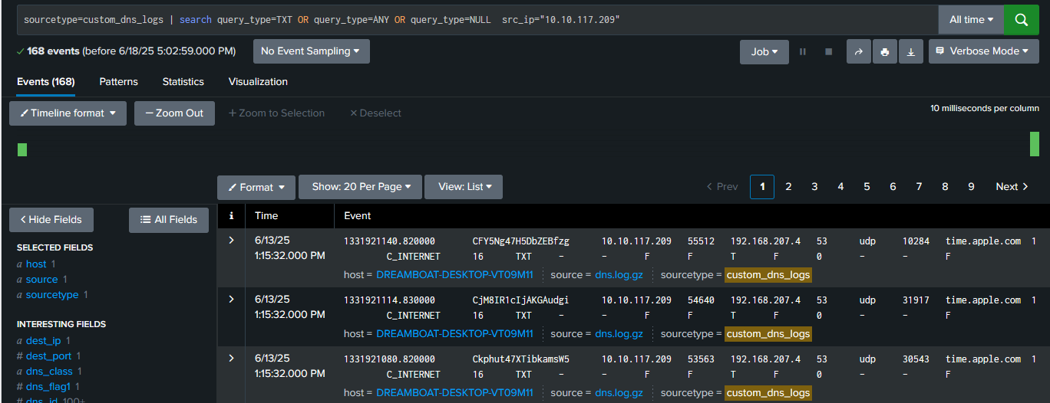
Frequent NXDOMAIN Responses

Slide 19
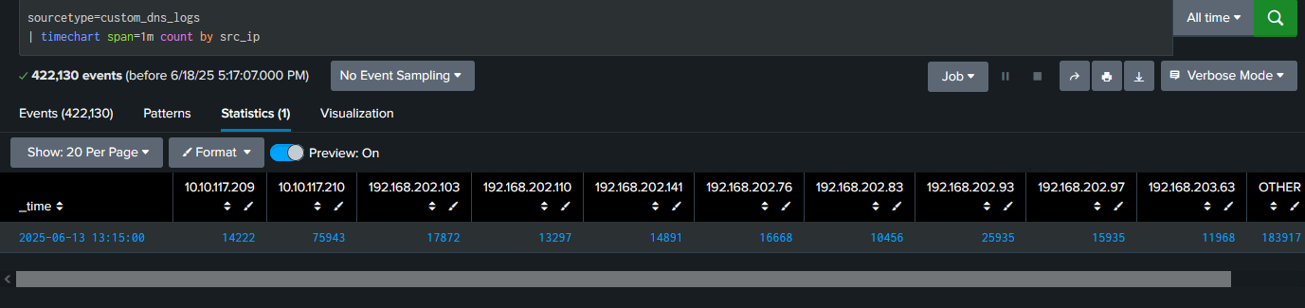
Investigating Suspicious Domains

Slide 20
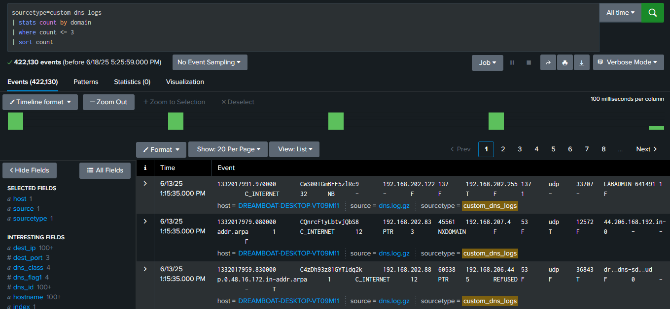
Spot Unusual or Rarely Queried Domains

Slide 21



With this step, I was being able to:
Detect weird or rare DNS traffic
Correlate it to IPs or systems
Prioritize domains for deeper investigation or threat hunting

Slide 22
Analyzing FTP Log Files Using Splunk SIEM

Slide 23
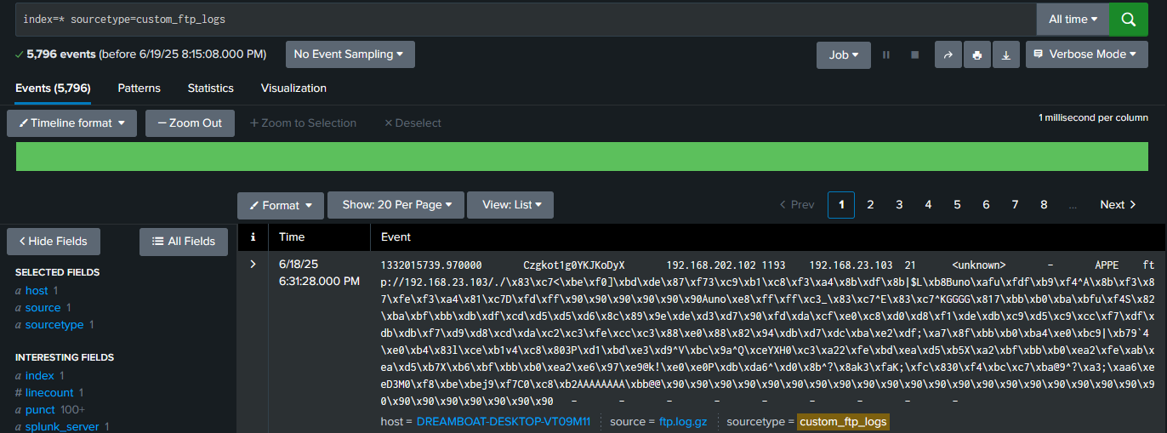
Verifying upload

Slide 24
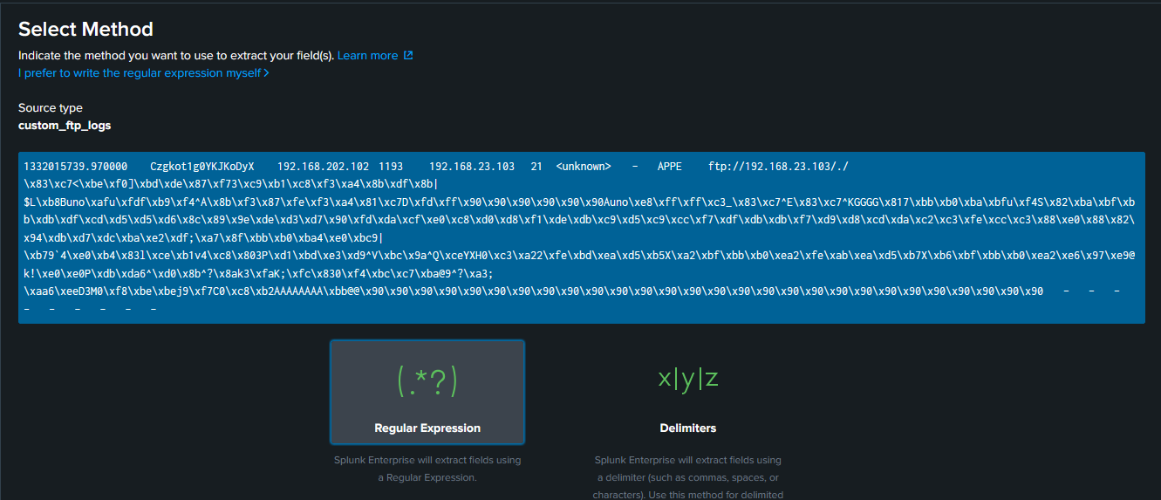
GUI Field Extractor

Slide 25
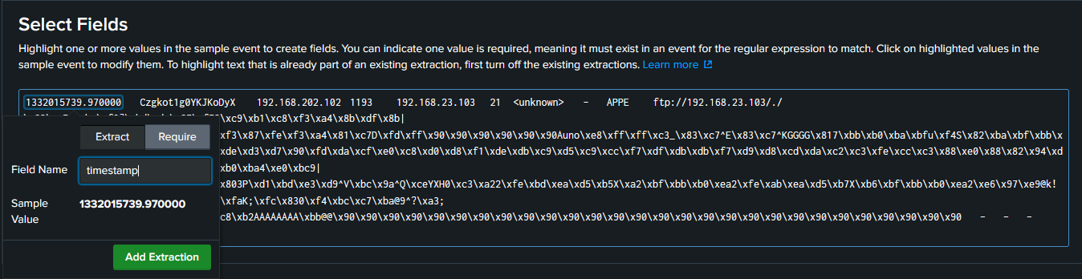
Highlighting each field in the sample event and name

Slide 26
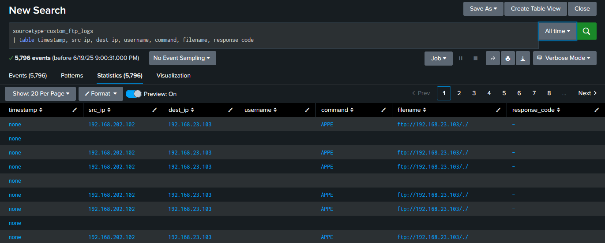
clean columns for each field.

Slide 27
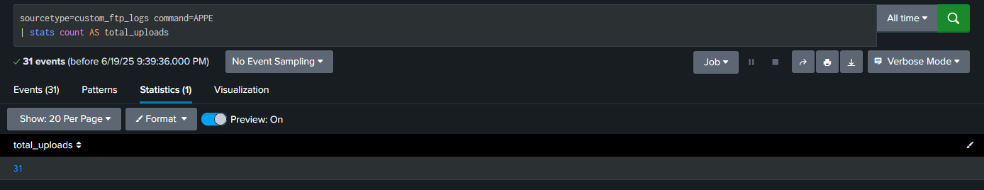
Determine Frequency and Volume of File Transfers
-Frequency of Uploads (APPE)
-Count the number of file transfers

Slide 28
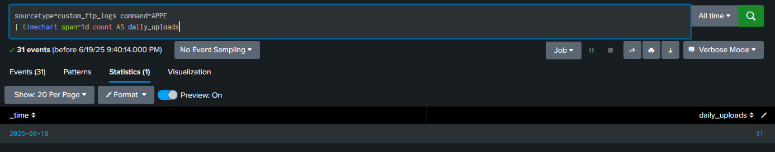
Daily Upload Trends
Track uploads over time:

Slide 29
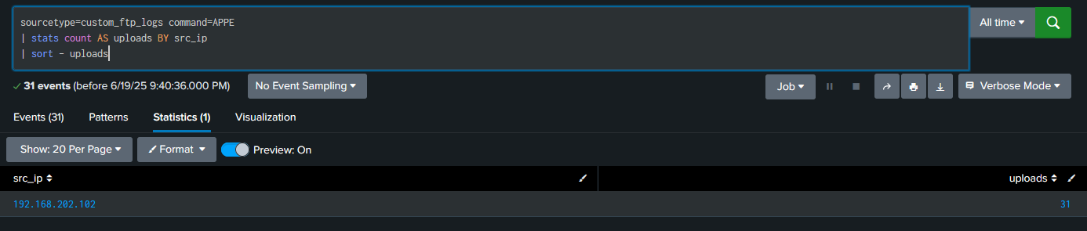
Top Source IPs by Upload Count
Identify most active uploader IP addresses:

Slide 30
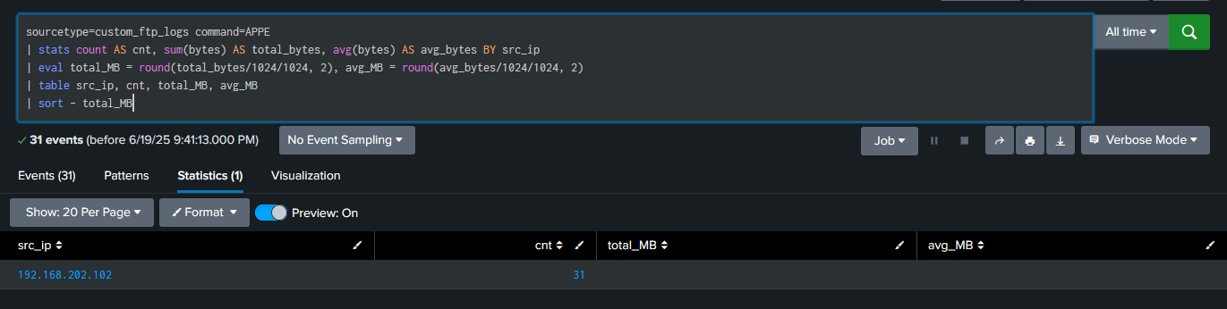
Transfer Volume—Total Bytes by IP/User
Sum and average bytes transferred:

Slide 31
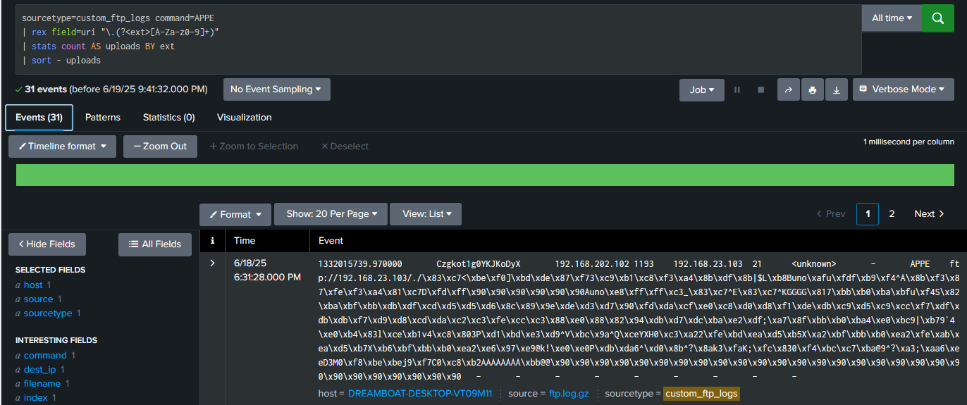
File Type Analysis
Extract file types from the URI

Slide 32
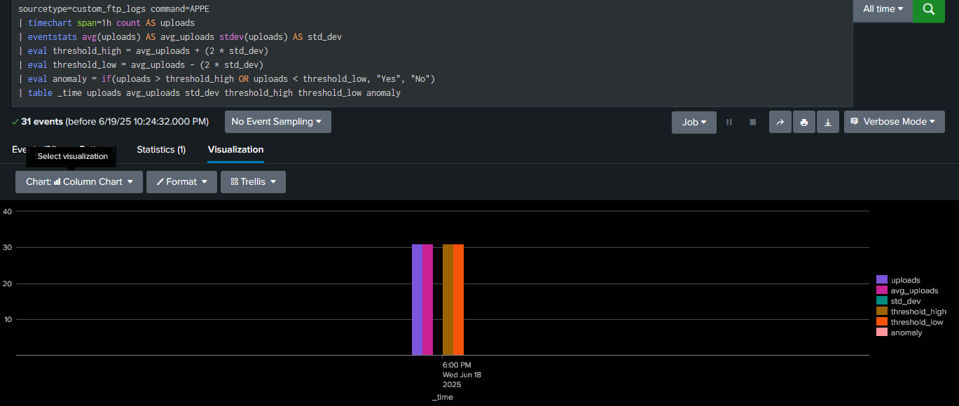
Detecting Sudden Spikes or Drops in File Transfers
This help me analyze file uploads over time to detect spikes or drops:
What This Does:
timechart shows uploads hourly.
Calculates average and standard deviation.
Flags uploads that are statistically abnormal (above or below 2σ).

Slide 33
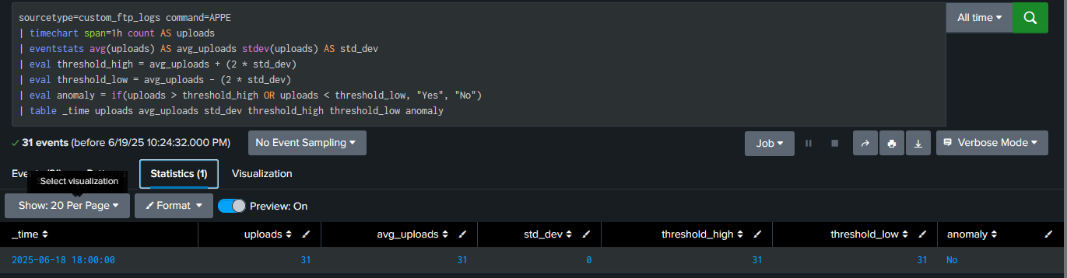
Detect Transfers to or from Suspicious IP Addresses

Slide 34
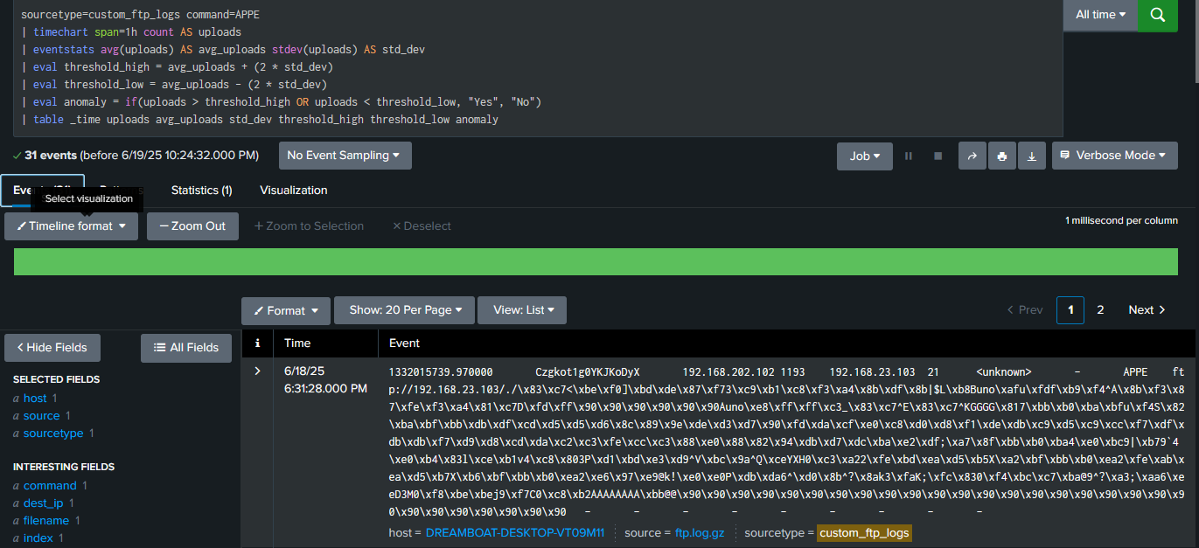
Statistical Outlier Detection Using outlier Command
This Splunk command helps flag unusual spikes in numeric time-series:

Slide 35
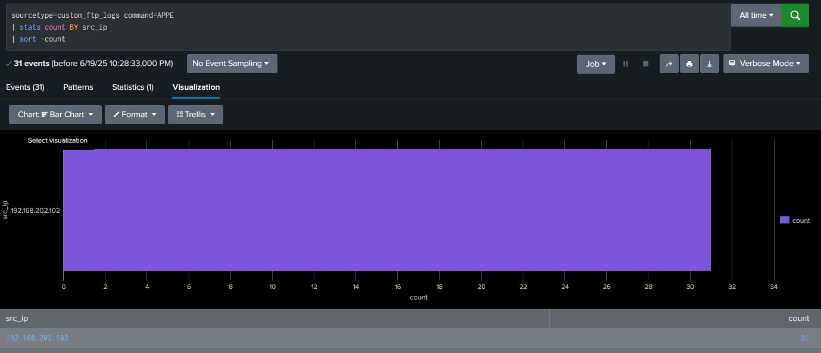
This will give me only those time buckets with anomalous upload volumes.

Slide 36
Detecting Anomalies in FTP File Transfer Logs Using Splunk
🎯 Project Objectives
Look for unusual patterns in file transfer activity.
Analyze sudden spikes or drops in transfer volume using time-based analysis.
Investigate file transfers to/from suspicious IP addresses.
Apply statistical or machine learning techniques to detect anomalies.

Slide 37
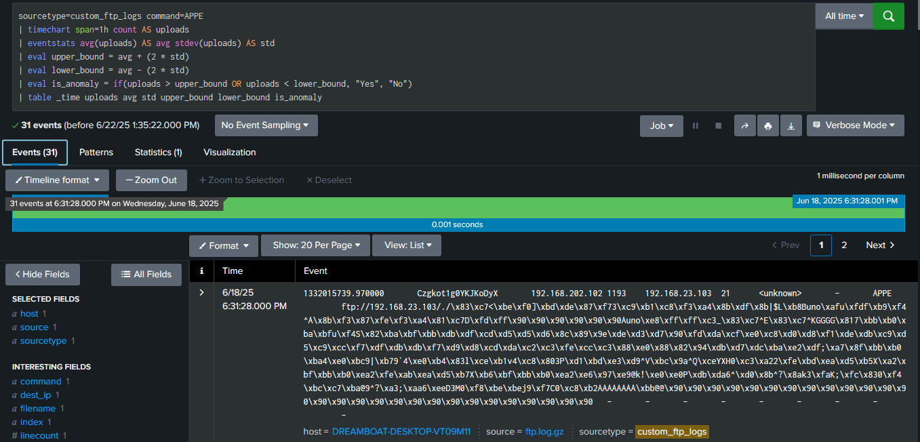
Time-Based Anomaly Detection. Purpose: Flag time ranges where transfer activity deviated from normal behavior.

Slide 38

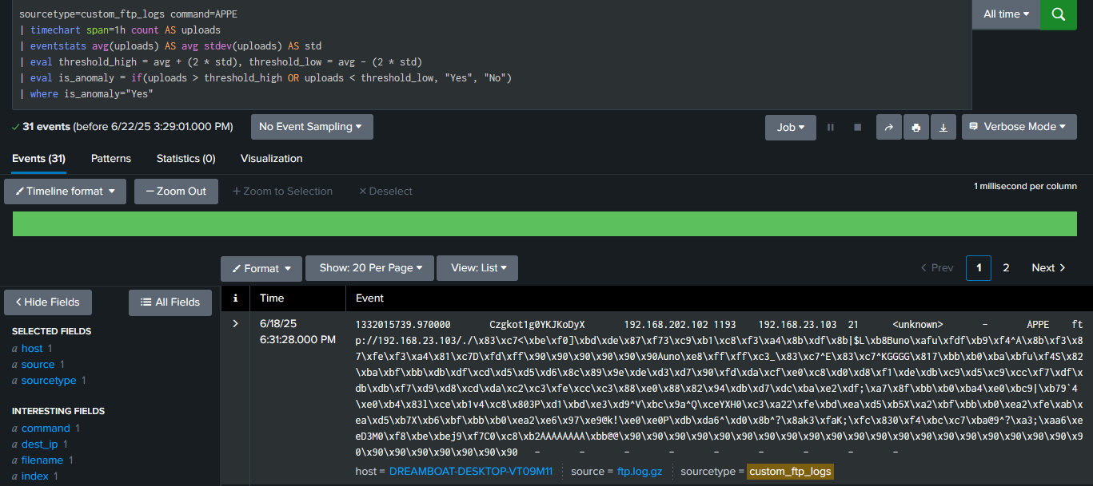
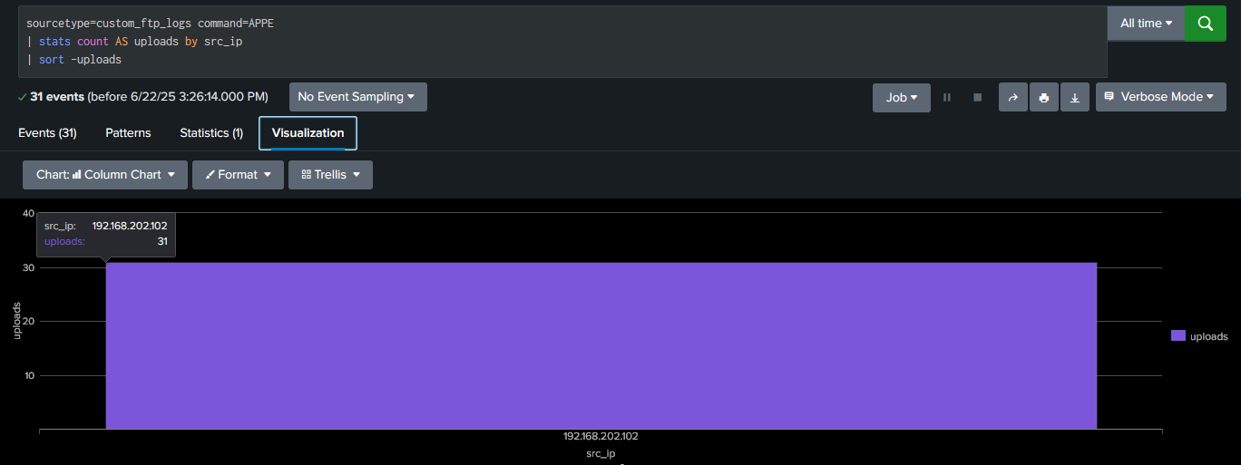
Detect Anomalies

Slide 39
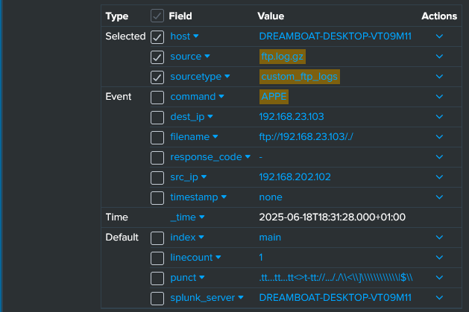
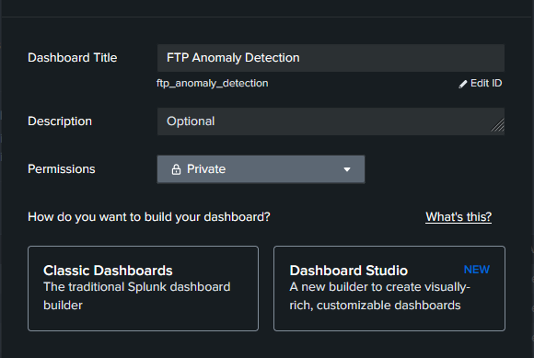
Look for unusual patterns in file transfer activity.
Analyze sudden spikes or drops in file transfer volume. Then setup my dashboard

Slide 40
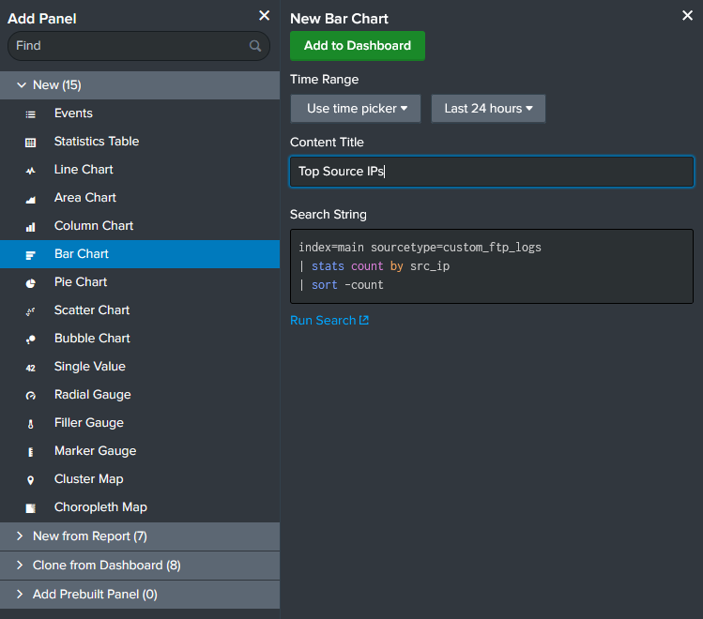
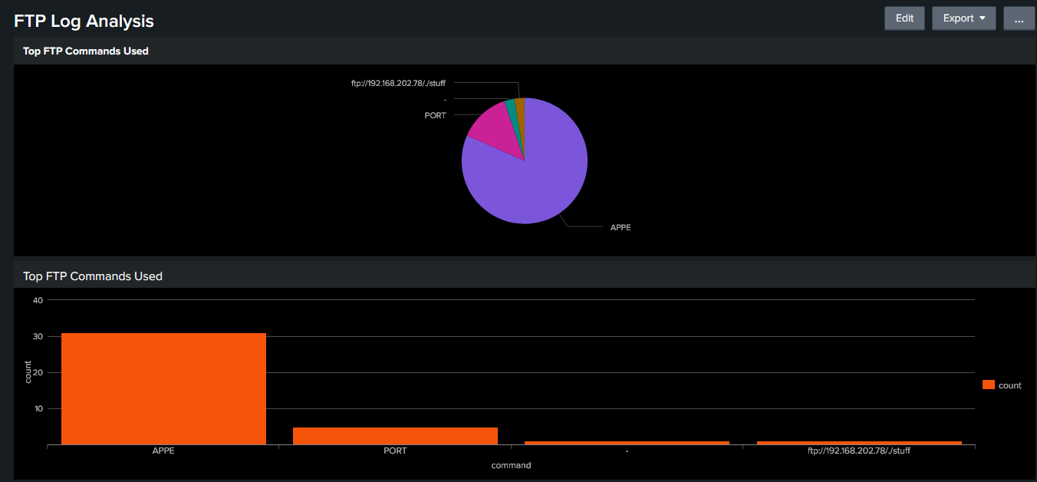
Investigate file transfers to or from suspicious IP addresses.
Use statistical analysis or machine learning models to detect anomalies.

Slide 41
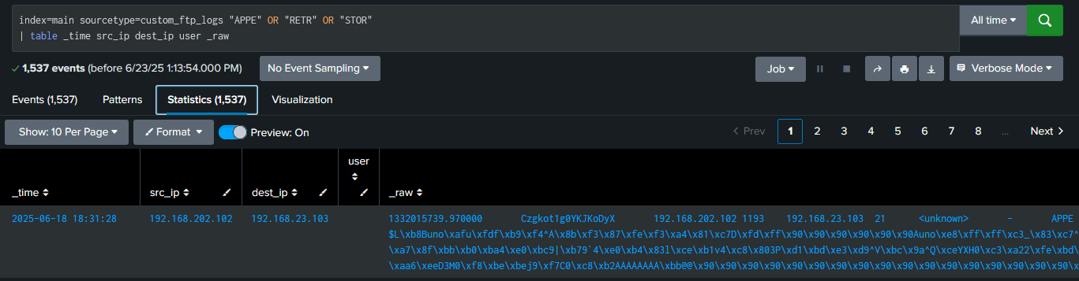
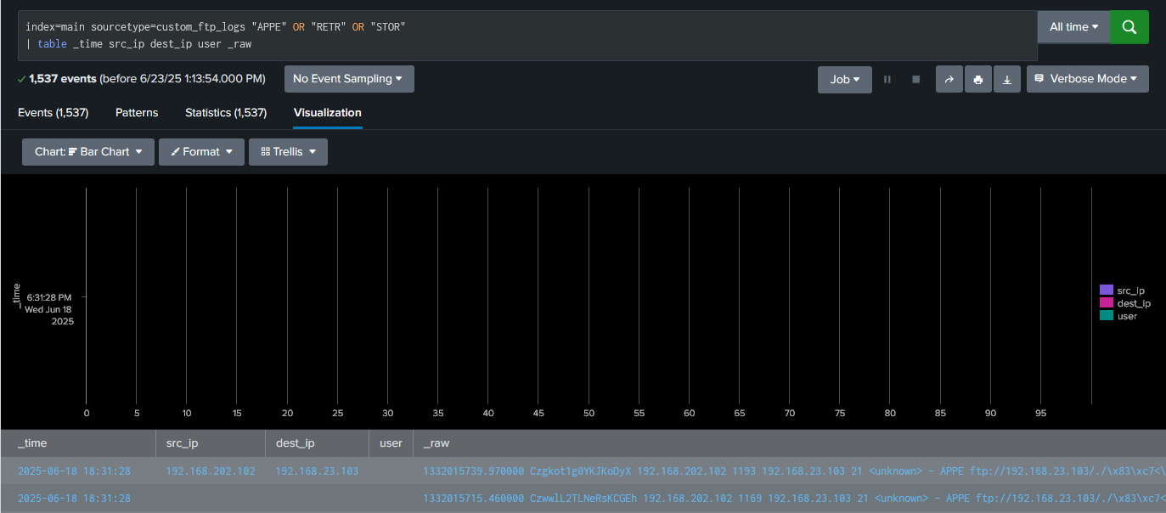
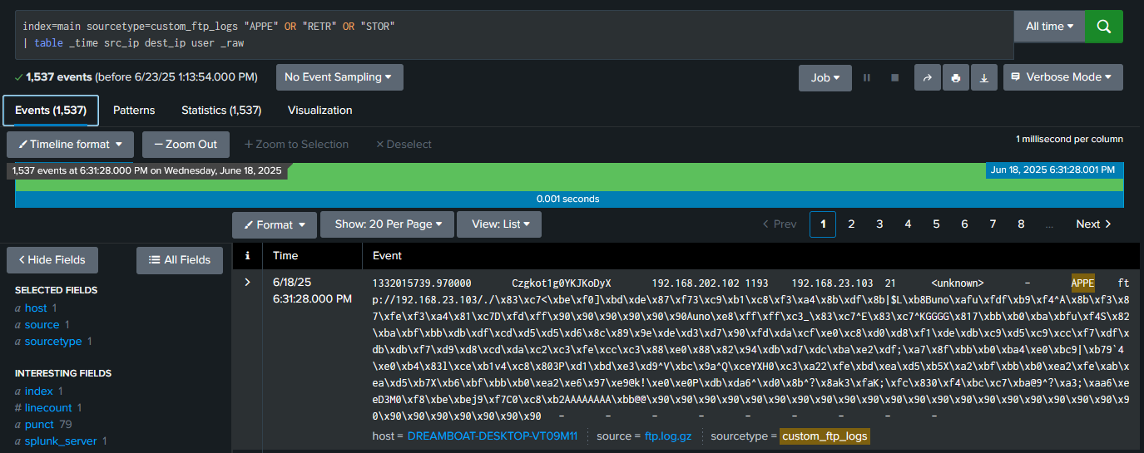
Monitor User Behavior – Goal Breakdown
Monitor user behavior during file transfers.
Identify users with multiple failed login attempts or unauthorized access attempts.
Analyze user activity patterns and deviations from normal behavior
This search shows user activity during file uploads and downloads (APPE, RETR, STOR), listing timestamps, source IPs, destination IPs, and any available user info. It Helps me detect suspicious file transfers.

Slide 42
Project: Analyzing HTTP Log Files Using Splunk SIEM
Objectives:
Upload and ingest HTTP log files into Splunk
Search and extract key fields (e.g., method, status code, URI, user-agent, IP)
Identify top hosts, status codes, and requested URLs
Detect anomalies (e.g., spike in 404s, suspicious user agents, brute-force patterns)
Visualize insights in a dashboard (e.g., top IPs, error trends, request volume)
Key Fields to Analyze:
src_ip or clientip
method (GET, POST, etc.)
uri / uri_path
status (200, 404, 500, etc.)
user_agent
referer
_time
📊 Example Insights:
Top requested resources
IPs with high 404/403 errors
Possible scanning or crawling activity
Suspicious request bursts (DoS or brute-force)
Abnormal HTTP methods (e.g., DELETE, PUT)

Slide 44
Summary
At Contoso, we believe in giving 110%. By using our next-generation data architecture, we help organizations virtually manage agile workflows. We thrive because of our market knowledge and great team behind our product. As our CEO says, "Efficiencies will come from proactively transforming how we do business."​

Slide 45
Thank you
Mirjam Nilsson​​
206-555-0146​
mirjam@contoso.com​
www.contoso.com​

